Slide 1
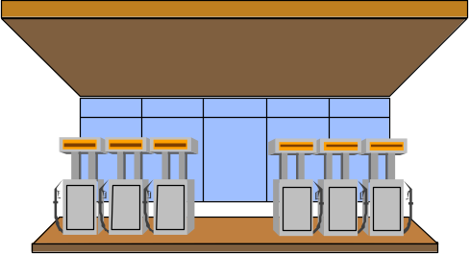

Pipelined Processor Design
Pipelining
  Static In-order Pipeline
    Dynamic out-of-order Pipeline
    Multiple pipeline
Hazards
  Control
  Data
  Resource
GAS STATION

Slide 2
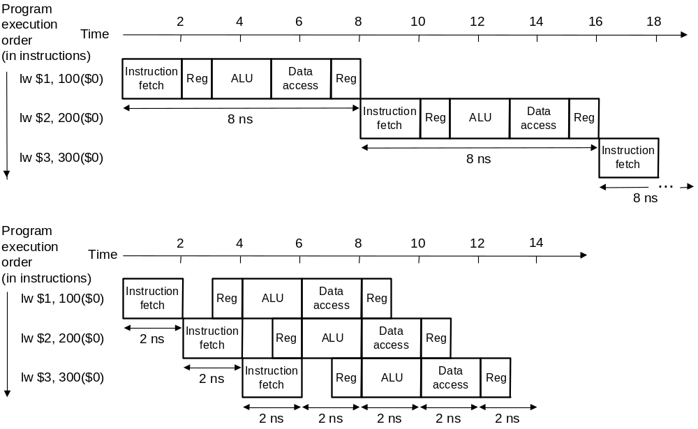
Pipelining
Improve perfomance by increasing instruction throughput
Ideally, Speedup_{pipeline} = Pipeline Depth
after start-up to fill up the pipe

Slide 3
Pipelining
What makes it easy
  all instructions are the same length
  just a few instruction formats
  memory operands appear only in loads and stores
What makes it hard?
  structural hazards: suppose we had only one memory
  control hazards: need to worry about branch instructions
  data hazards: an instruction depends on a previous instruction

Slide 4
MIPS Pipeline Stages
Stage 1: Instruction Fetch (IF)
Stage 2: Instruction Decode (ID)
Stage 3: Execute (EX)
Stage 4: Memory Access (M)
Stage 5: Write Back (to register file) (WB)
NOTE: slight change in stages
Dividing data path with intermediate storage
Generating control signal
Taking care of conflicts and dependency (hazards)

Slide 5
Recall: Complete Single-cycle Datapath
Current PC
M
U
X
4
Adder
no jump
PC
Instruction
Memory (RAM)
<< 2
ADDER
Register File
Data Memory
(RAM)
Instruction
Zero
Read Reg 1
Read Reg 2
Write Reg
Write Data
Read
Data 1
Read
Data 2
M
U
X
M
U
X
ALU
Read
data
Write
Data
Sign
extend
16
32

Slide 6
Partition the Datapath & Separate the Different Stages
STAGE 1
IF
STAGE2
ID
STAGE 3
EX
STAGE 4
Mem
STAGE 5
WB
Current PC
4
Adder
PC
R
E
G
I
S
T
E
R
S
R
E
G
I
S
T
E
R
S
R
E
G
I
S
T
E
R
S
R
E
G
I
S
T
E
R
S
Register File
Data Memory
(RAM)
ALU
Read Reg 1
Read Reg 2
Write Reg
Write Data
Read
Data 1
Read
Data 2
M
U
X
M
U
X
Instruction
Memory (RAM)
Read
data
Write
Data
Sign
extend
16
32
based on single cycle data path

Slide 7
5 Stage Pipeline with BEQ
M
U
X
Current PC
IF/ID
ID/EX
EX/MEM
MEM/WB
4
Adder
<< 2
ADDER
PC
Data Memory
cache
Register File
Read Reg 1
Read Reg 2
Write Reg
Write Data
Zero
Read
Data 1
Read
Data 2
M
U
X
M
U
X
Instruction
Memory cache
ALU
Read
data
Sign
extend
16
32

Slide 8
Flow of Instructions Through Pipeline
Time
Program
Execution
Clock
Cycle 1
Clock
Cycle 2
Clock
Cycle 3
Clock
Cycle 4
Clock
Cycle 5
Clock
Cycle 6
Clock
Cycle 7
Clock
Cycle 8
ADD R2,R3,R1
SUB R5,R6,R7
ADD R10,R11,R12
IM
Reg
REG
DM
IM
REG
DM
Reg
IM
REG
DM
Reg

Slide 9
Pipeline Control
C
O
N
T
R
O
L
WB
M
U
X
M
WB
EX
M
WB
Current PC
IF/ID
ID/EX
EX/MEM
MEM/WB
4
Adder
<< 2
ADDER
PC
ALU Control
Data Memory
(RAM)
Register File
Read Reg 1
Read Reg 2
Write Reg
Write Data
Zero
Read
Data 1
Read
Data 2
M
U
X
M
U
X
Instruction
Memory (RAM)
ALU
Read
data
Sign
extend
16
32
carry instruction itself + PC + control signals

Slide 10
Data Hazards
Programs assume instructions are executed sequentially with one instruction completing before the next one begins
  Usually the compiler assumes the single machine model
Pipelining violates this assumption
Dependencies can occur between instructions executing concurrently within the pipeline - if the dependencies are based on data requirements, we call them Data Hazards
Types of data hazards
  Read-after-write (RAW)
    A true dependency
  Write-after-read (WAR)
    Artificial dependency due to register assignment
  Write-after-write (WAW)
    Artificial dependency due to register assignment

Slide 11
Solution 1 : Stall
ADD R10, R11, R12
ADD R12, R10, R11
ADD R11, R10, R9
IM
REG
DM
Reg
IM
bubble
bubble
bubble
REG
DM
IM
bubble
bubble
bubble
REG
bubble: delay – nop or actual delay or something else

Slide 12
Stall Conditions
Need to detect data hazard
  Occurs when one instruction tries to read result from previous instruction that hasn’t completed yet.
    Block depending instruction to go further
    Stop IF
  Specifically,
    When Instruction in Execute stage tries to read a register that an instruction in the MemAcc or WB stages will write back to the Register File
  Textbook Notation
    ID/EX.RegisterRs refers to the number of the first source register found in the pipeline register ID/EX.
    ID/EX. RegisterRt refers to the number of the second source register found in the pipeline register ID/EX.

Slide 13
Recall What an Instruction Looks Like
add R8, R17, R18
  is stored in binary format as
    00000010 00110010 01000000 00100000
  MIPS lays out instructions into “fields”
  op operation of the instruction
  rs first register source operand
  rt second register source operand
  rd register destination operand
  shamt shift amount
  funct function (select type of operation)
31 26 25 21 20 16 15 11 10 6 5 0
op rs rt rd shamt funct

Slide 14
Remember the Registers In Between Each Stage
holds IR copy + PC copy
M
U
X
Current PC
IF/ID
ID/EX
EX/MEM
MEM/WB
4
Adder
<< 2
ADDER
PC
Data Memory
(RAM)
Register File
Read Reg 1
Read Reg 2
Write Reg
Write Data
Zero
Read
Data 1
Read
Data 2
M
U
X
M
U
X
Instruction
Memory (RAM)
ALU
Read
data
Sign
extend
16
32

Slide 15
Data Hazard Stall Conditions
  Hazard Detection:
  1a EX/MEM. RegisterRd == ID/EX.RegisterRs
  1b EX/MEM.RegisterRd == ID/EX. RegisterRt
  2a MEM/WB. RegisterRd == ID/EX. RegisterRs
  2b MEM/WB. RegisterRd == ID/EX. RegisterRt
  Note:
  1. the idea is comparing the instruction at ID stage with previous instructions; if matches, stall the pipe.
  2. Multiple IRs(Instruction registers) = registers in between
  The instruction passed the ID stage is called “instruction issued”.
  So, rephrasing 1 can be: compare the instruction at decode stage with the instructions issued.

Slide 16
Example
  sub R2, R1, R3 Rd = R2 Rs = R1 Rt = R3
  and R12, R2, R5 Rd = R12 Rs = R2 Rt = R5
  or R13, R6, R2 Rd = R13 Rs = R6 Rt = R2
  add R14, R2, R2 Rd = R14 Rs = R2 Rt = R2
  sw R15, 100(R2) Rd = R15 Rs = R2 Rt = XX
SUB-AND Hazard
  EX/MEM.RegisterRd == ID/EX. RegisterRs == R2
SUB-OR Hazard
  MEM/WB.RegisterRd == ID/EX. RegisterRt == R2
Do we care about the interaction between sub (instruction 1) and add (instruction 4)?

Slide 17
No Dependence Between Instruction 1 and 4
assume write and read to the same register in the same cycle
Program
Execution
Clock
Cycle 1
Clock
Cycle 2
Clock
Cycle 3
Clock
Cycle 4
Clock
Cycle 5
Clock
Cycle 6
Clock
Cycle 7
Clock
Cycle 8
SUB R2, R1, R3
AND R12, R2, R5
OR R13, R6, R2
ADD R14, R2, R2
IM
REG
DM
REG
IM
REG
DM
REG
IM
REG
DM
REG
IM
REG
DM
REG

Slide 18
How Do We Stall the Pipeline?
Compiler can insert NOPS
Hardware Can Simulate NOPS
  Do not activate the IF stage until hazard
  condition is removed
  Forward NOP, i.e. no active control signals for WB or PC-write or Memory-write
Reducing Data Hazards: Forwarding
Data may be already computed
- just not in the Register File yet
Bypass register file and directly forward to where needed
  - new bypass data path

Slide 19
Additions to the Datapath for Forwarding
M
U
X
Current PC
IF/ID
ID/EX
EX/MEM
MEM/WB
4
Adder
<< 2
ADDER
PC
Data Memory
(RAM)
Register File
Read Reg 1
Read Reg 2
Write Reg
Write Data
Read
Data 1
Read
Data 2
Zero
M
U
X
M
U
X
Instruction
Memory (RAM)
ALU
Read
data
Sign
extend
16
32

Slide 20
Forwarding Continued
ADD R10, R11, R12
ADD R12, R10, R11
ADD R4, R5, R10
IM
ALU
DM
Reg
REG
IM
REG
ALU
DM
Reg
IM
REG
ALU
DM
Reg

Slide 21
More Additions to the Datapath
M
U
X
Current PC
IF/ID
ID/EX
EX/MEM
MEM/WB
4
Adder
<< 2
ADDER
PC
Data Memory
(RAM)
Register File
Read Reg 1
Read Reg 2
Write Reg
Write Data
Zero
Read
Data 1
Read
Data 2
M
U
X
M
U
X
Instruction
Memory (RAM)
ALU
Read
data
Sign
extend
16
32

Slide 22
More Additions to the Datapath
both A and B are possible forwarding destinations
M
U
X
Current PC
IF/ID
ID/EX
EX/MEM
MEM/WB
4
Adder
<< 2
ADDER
PC
Data Memory
(RAM)
Register File
M
U
X
A
Read Reg 1
Read Reg 2
Write Reg
Write Data
Zero
Read
Data 1
Read
Data 2
M
U
X
M
U
X
Instruction
Memory (RAM)
ALU
Read
data
B
Sign
extend
16
32

Slide 23
Add forwarding unit for proper control
M
U
X
Current PC
IF/ID
ID/EX
EX/MEM
MEM/WB
4
Adder
<< 2
ADDER
PC
A
Data Memory
(RAM)
Register File
M
U
X
Read Reg 1
Read Reg 2
Write Reg
Write Data
Zero
Read
Data 1
Read
Data 2
B
M
U
X
M
U
X
Instruction
Memory (RAM)
ALU
Read
data
Sign
extend
16
32
ForwardA
Forwarding Unit
ForwardB

Slide 24
Add control part for forwarding
Two cases – at EX and at Mem
  At Ex :
    add r1, r2, r3 add r1, r2,r3
    sub r4, r1, r5 or r6, r7, r1
    when sub/or instruction reads operands of r1, the producer(add) is in EX stage. The value of r1 can be read from EX/MEM register.
    if (EX/MEM.RegWrite
    and (EX/MEM.RegisterRd != 0)
    and (Ex/MEM.RegisterRd = ID/EX.RegisterRs)
    ForwardA = 2;
    if (EX/MEM.RegWrite
    and (EX/MEM.RegisterRd != 0)
    and (Ex/MEM.RegisterRd = ID/EX.RegisterRt)
    ForwardB = 2;
or

Slide 25
Add control part for forwarding(cont’)
  At Mem :
    add r1, r2, r3 add r1, r2,r3
    add r8, r3, r4 add r8, r3, r4
    sub r4, r1, r5 or r6, r7, r1
    when sub/or instruction reads operands of r1, the producer(add) is in MEM stage. The value of r1 can be read from MEM/WB register.
    if (MEM/WB.RegWrite
    and (MEM/WB.RegisterRd != 0)
    and (MEM/WB.RegisterRd = ID/EX.RegisterRs)
    ForwardA = 3;
    if (MEM/WB.RegWrite
    and (MEM/WB.RegisterRd != 0)
    and (MEM/WB.RegisterRd = ID/EX.RegisterRt)
    ForwardB = 3;
or

Slide 26
Complete forwarding unit
M
U
X
Current PC
IF/ID
ID/EX
EX/MEM
MEM/WB
4
Adder
<< 2
ADDER
PC
3
A
Data Memory
(RAM)
Register File
M
U
X
Read Reg 1
Read Reg 2
Write Reg
Write Data
2
Zero
Read
Data 1
Read
Data 2
M
U
X
M
U
X
Instruction
Memory (RAM)
2
B
ALU
Read
data
Sign
extend
3
ID/EX.rs
ID/EX.rt
16
32
EX/MEM.rd
Forwarding Unit
MEM/WB.rd

Slide 27
Forwarding Doesn’t Always Work
LW R10, 0x00(R4)
ADD R12, R10, R11
IM
REG
ALU
DM
Reg
IM
REG
ALU
DM
Reg

Slide 28
Loads and Stores Require a Load Delay Slot
LW R10, 0x00(R4)
nop
ADD R12, R10, R11
IM
ALU
DM
Reg
REG
IM
bubble
IM
REG
ALU
DM
Reg

Slide 29
MIPS Load-Delay Slot
MIPS exposed the load-delay slot to the compiler
  This makes it part of the architecture, not just an implementation detail
  Therefore, it’s up to the compiler (or assembly code writer) to make sure that the instruction after a load does not depend on the result of the load
An alternative would have been to force the hardware to detect the data hazard and stall the pipeline
  Most of today’s architectures detect the hazard and stall

Slide 30
Example of Forwarding and Load Delay
Rewrite the code assuming a machine without forwarding (by inserting nops).
  ADD R4, R5, R2
  LW R2, 0(R4)
  SW R15, 4(R2)
Rewrite the code assuming forwarding

Slide 31
Solution Templete
Between ADD and LW Without Forwarding
  ADD R4, R5, R2
  NOP
  NOP
  LW R2, 0(R4)
IF ID EX M WB
IF ID …
IF ID …
IF ID EX M WB

Slide 32
Solution Templete
Between LW and SW Without Forwarding
  LW R2, 0(R4)
  NOP
  NOP
  SW R15, 4(R2)
IF ID EX M WB
IF ID …
IF ID …
IF ID EX M WB

Slide 33
Solution Templete – putting together
Without Forwarding
  ADD R4, R5, R2
  nop
  nop
  LW R2, 0(R4)
  nop
  nop
  SW R15, 4(R2)
IF ID EX M WB
IF ID EX M WB
IF ID EX …

Slide 34
Solution Templete
  ADD R4, R5, R2
  LW R15, 0(R4)
  nop
  ADD R5, R15, R6
With Forwarding
  ADD R4, R5, R2
  LW R15, 0(R4)
  ADD R5, R15, R6
IF ID EX M WB
IF ID EX M WB
IF ID EX M

Slide 35
Announcement
The first Exam will be on May 11 (Wed). It will be 90 min. exam and cover the class materials up to Lect. 4.2 (Textbook Sec. 4.7).

